Slide 1

Us Cost of Living
CIS 5550 – Business Analytics
An Mach
Ankita Savaliya
Bhumika Suvagia
Manimozhi Neethinayagam

Slide 2
Agenda
Introduction
Dataset Cleaning
Interactive Dashboard
Story Telling
Limitation and Future Enhancement
Conclusion

Slide 3
introduction
Why have we chosen this project?
Factors that affecting the cost of living:
Housing
Transportation
Food
Childcare
Healthcare
What can we learn?

Slide 4
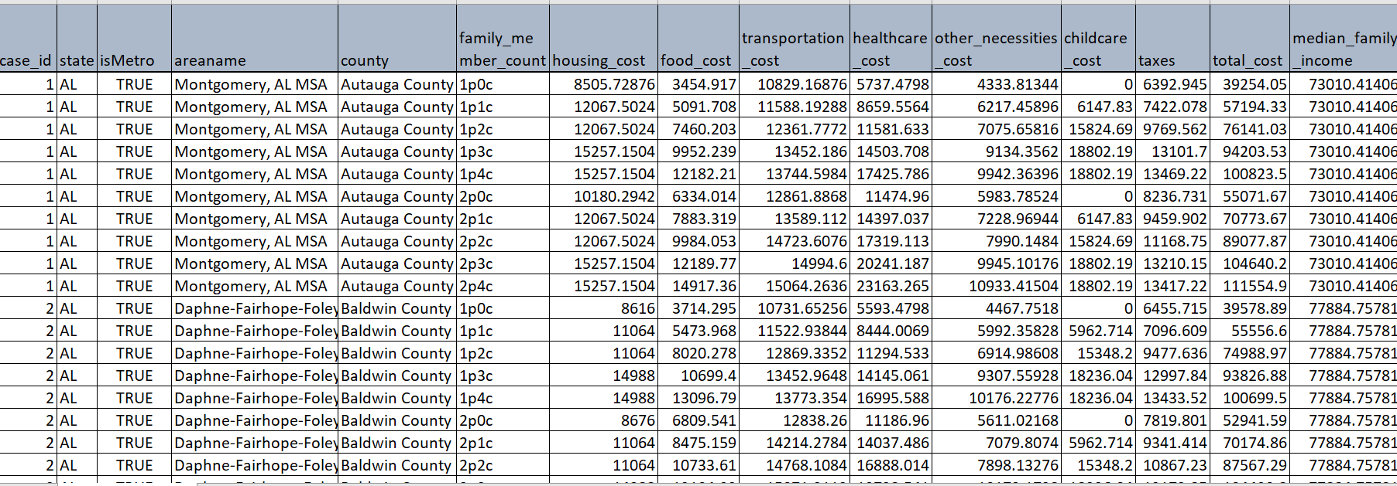
Dataset Description
To analyze the pattern, we used US Cost of Living dataset from Kaggle.
https://www.kaggle.com/datasets/asaniczka/us-cost-of-living-dataset-3171-counties/data
The dataset is a comprehensive collection of data related to the cost of living in different 1877 US counties based on the Family Budget Calculator by the Economic Policy Institute (EPI).

Slide 5
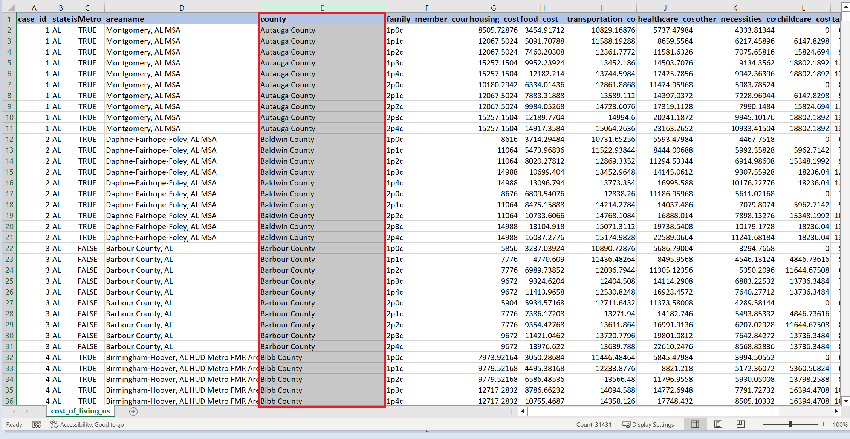
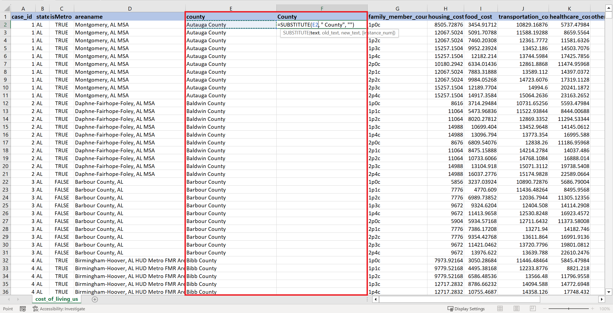
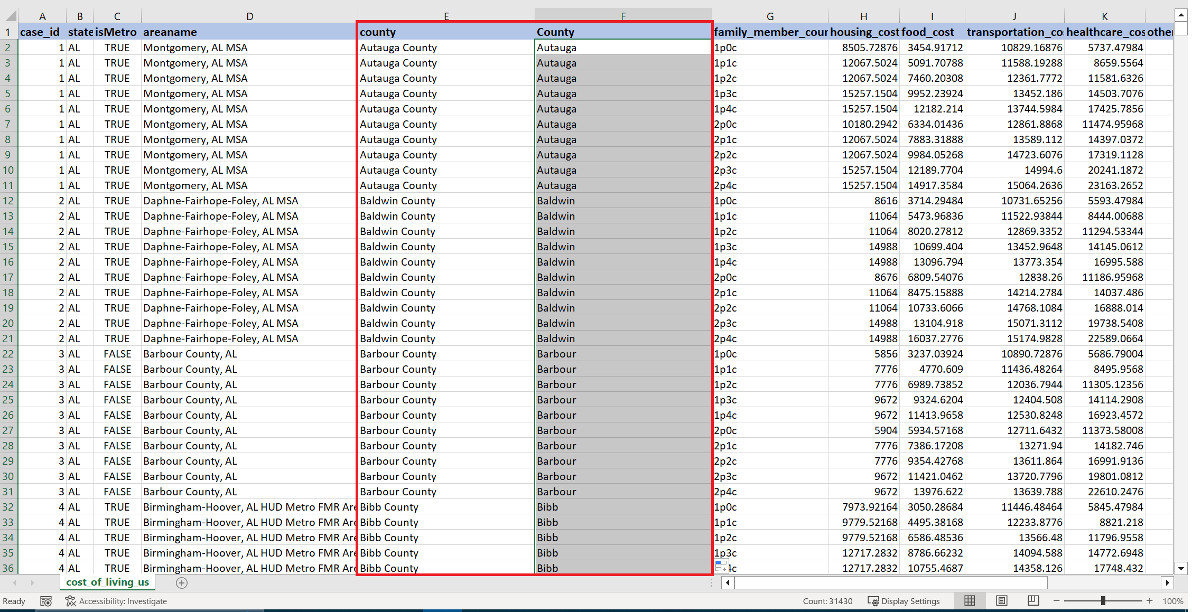
Data Cleaning
1. Removing Repeated Word
Before:
After:

Slide 6
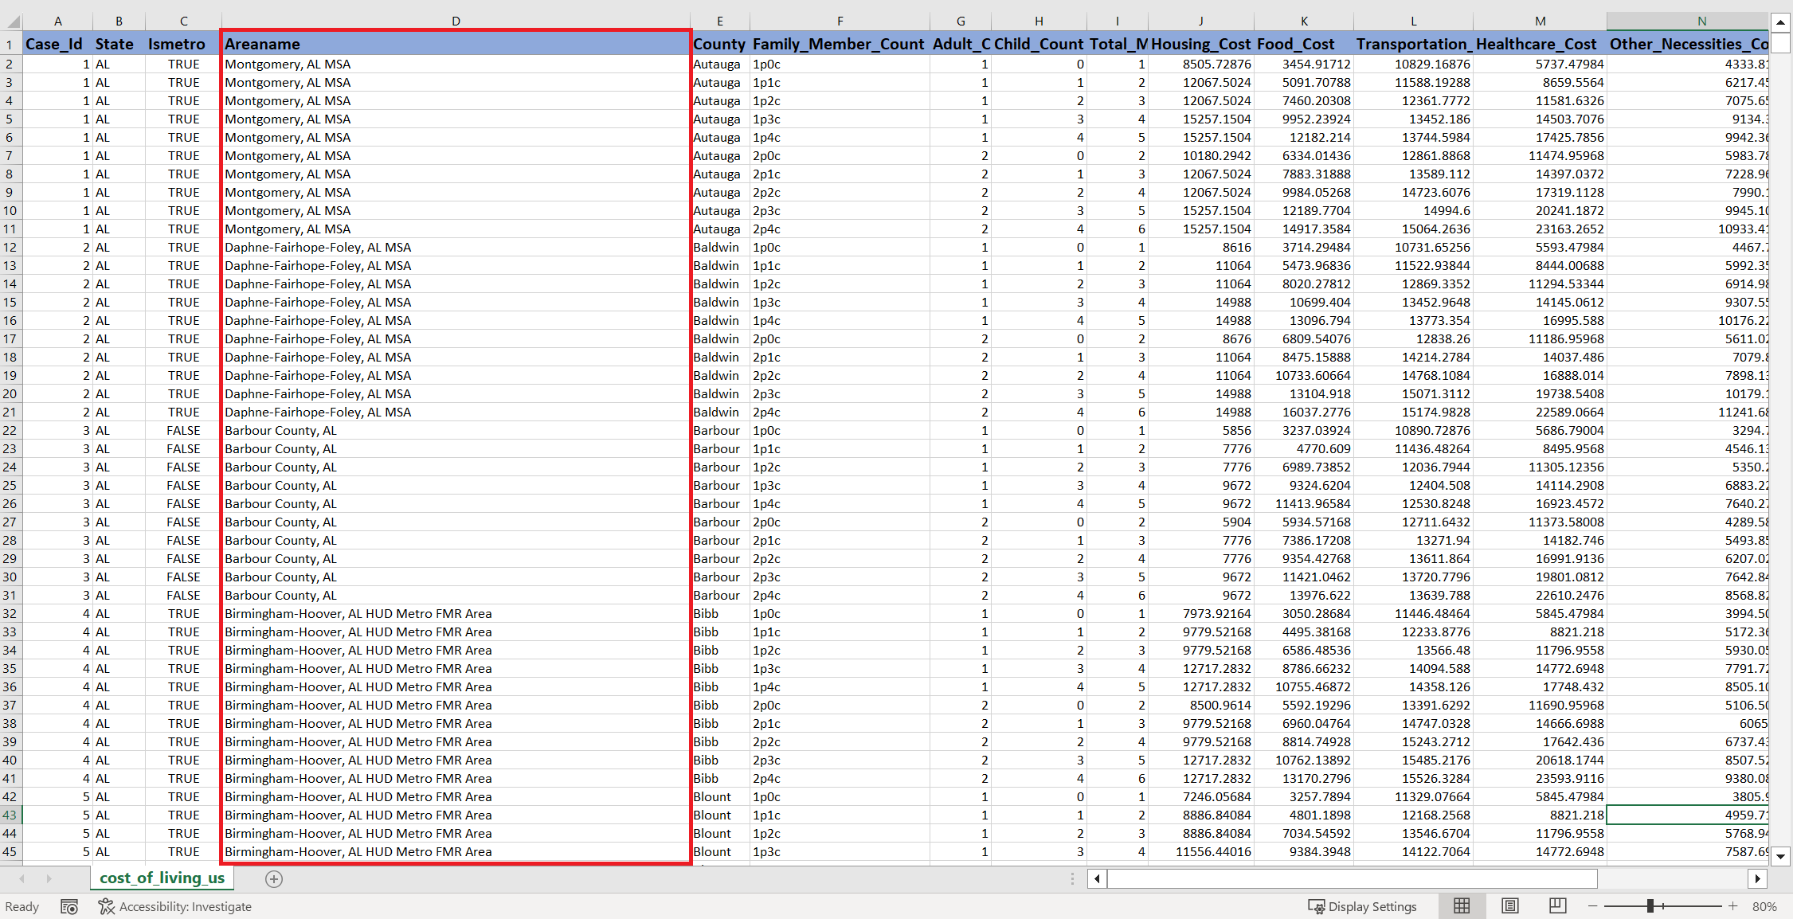
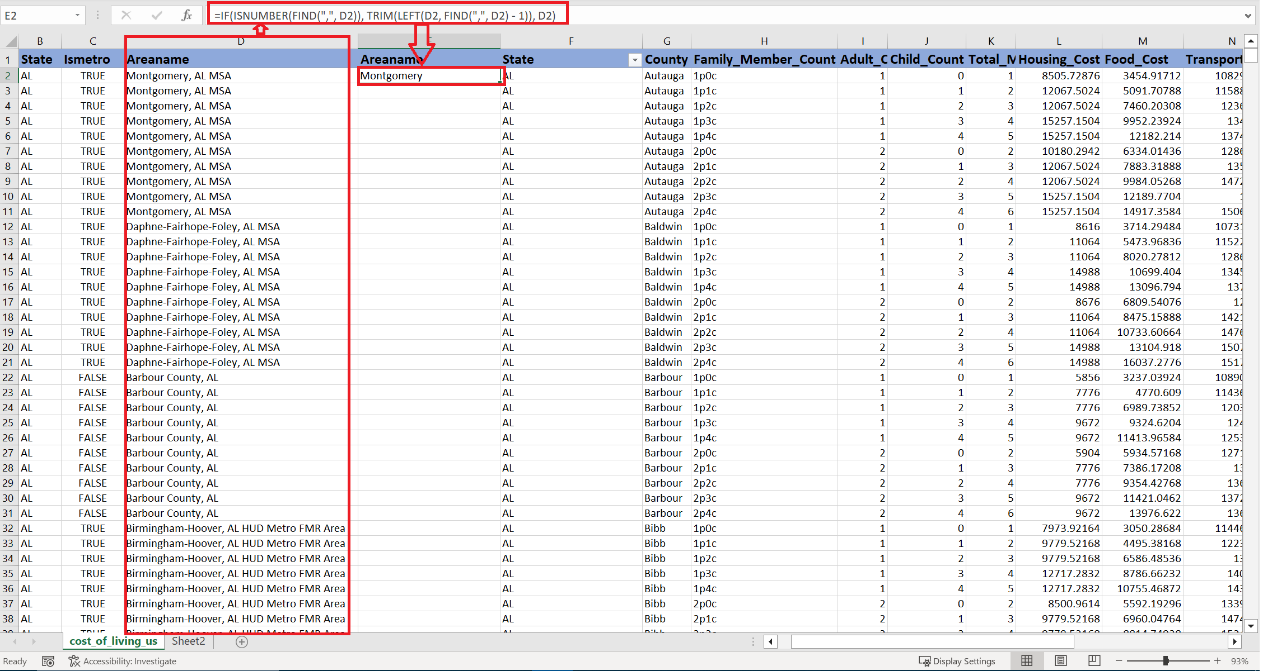
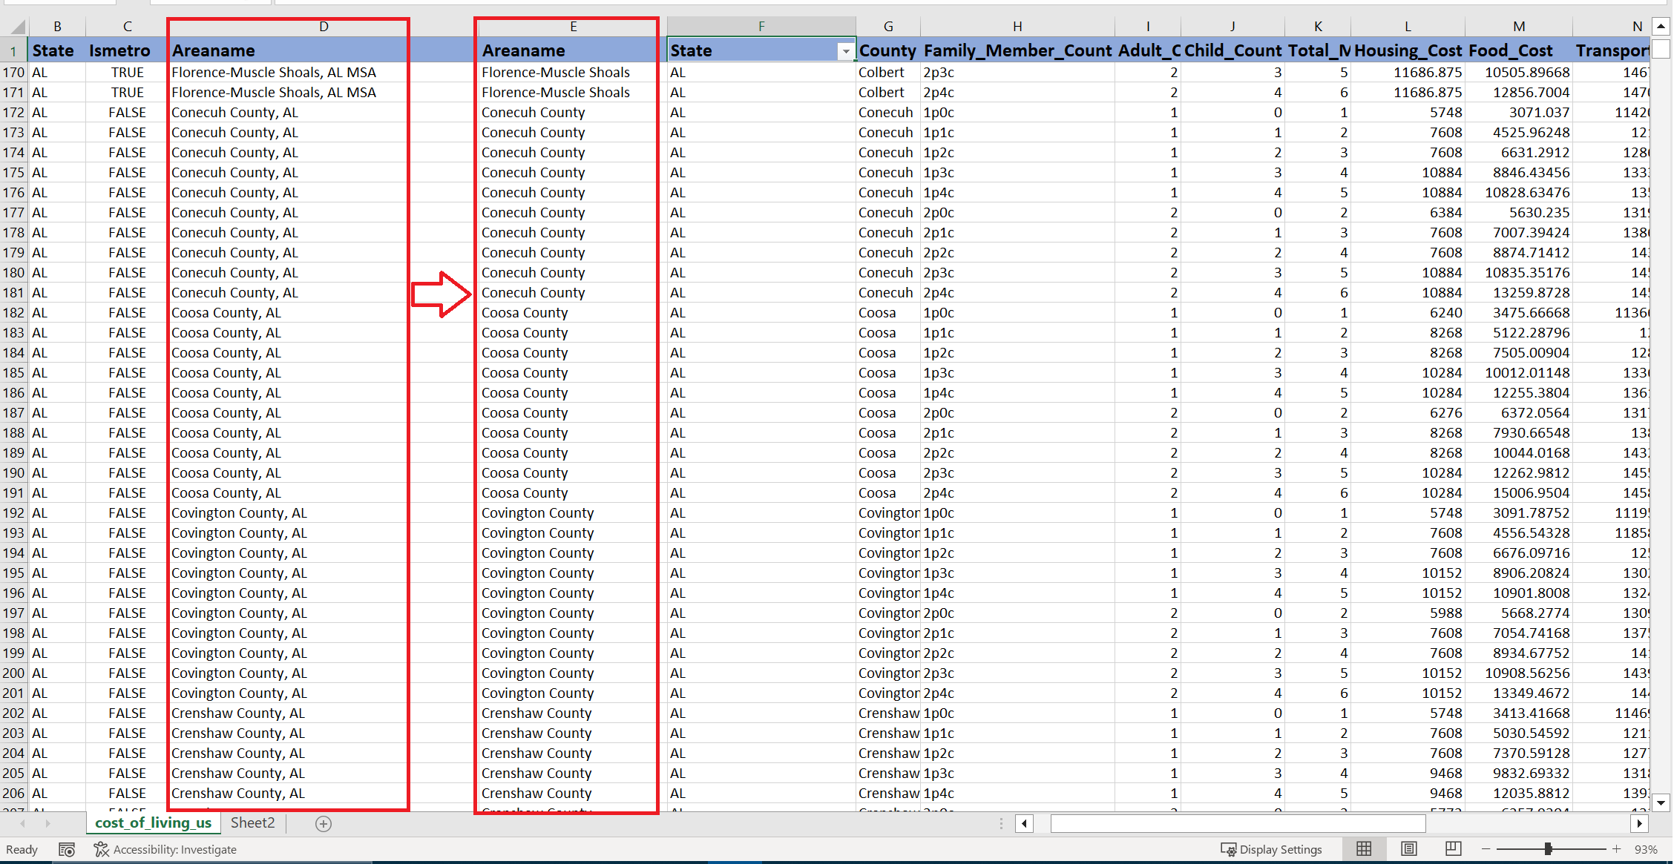
2. Extracting AreaName
Before:
After:

Slide 7
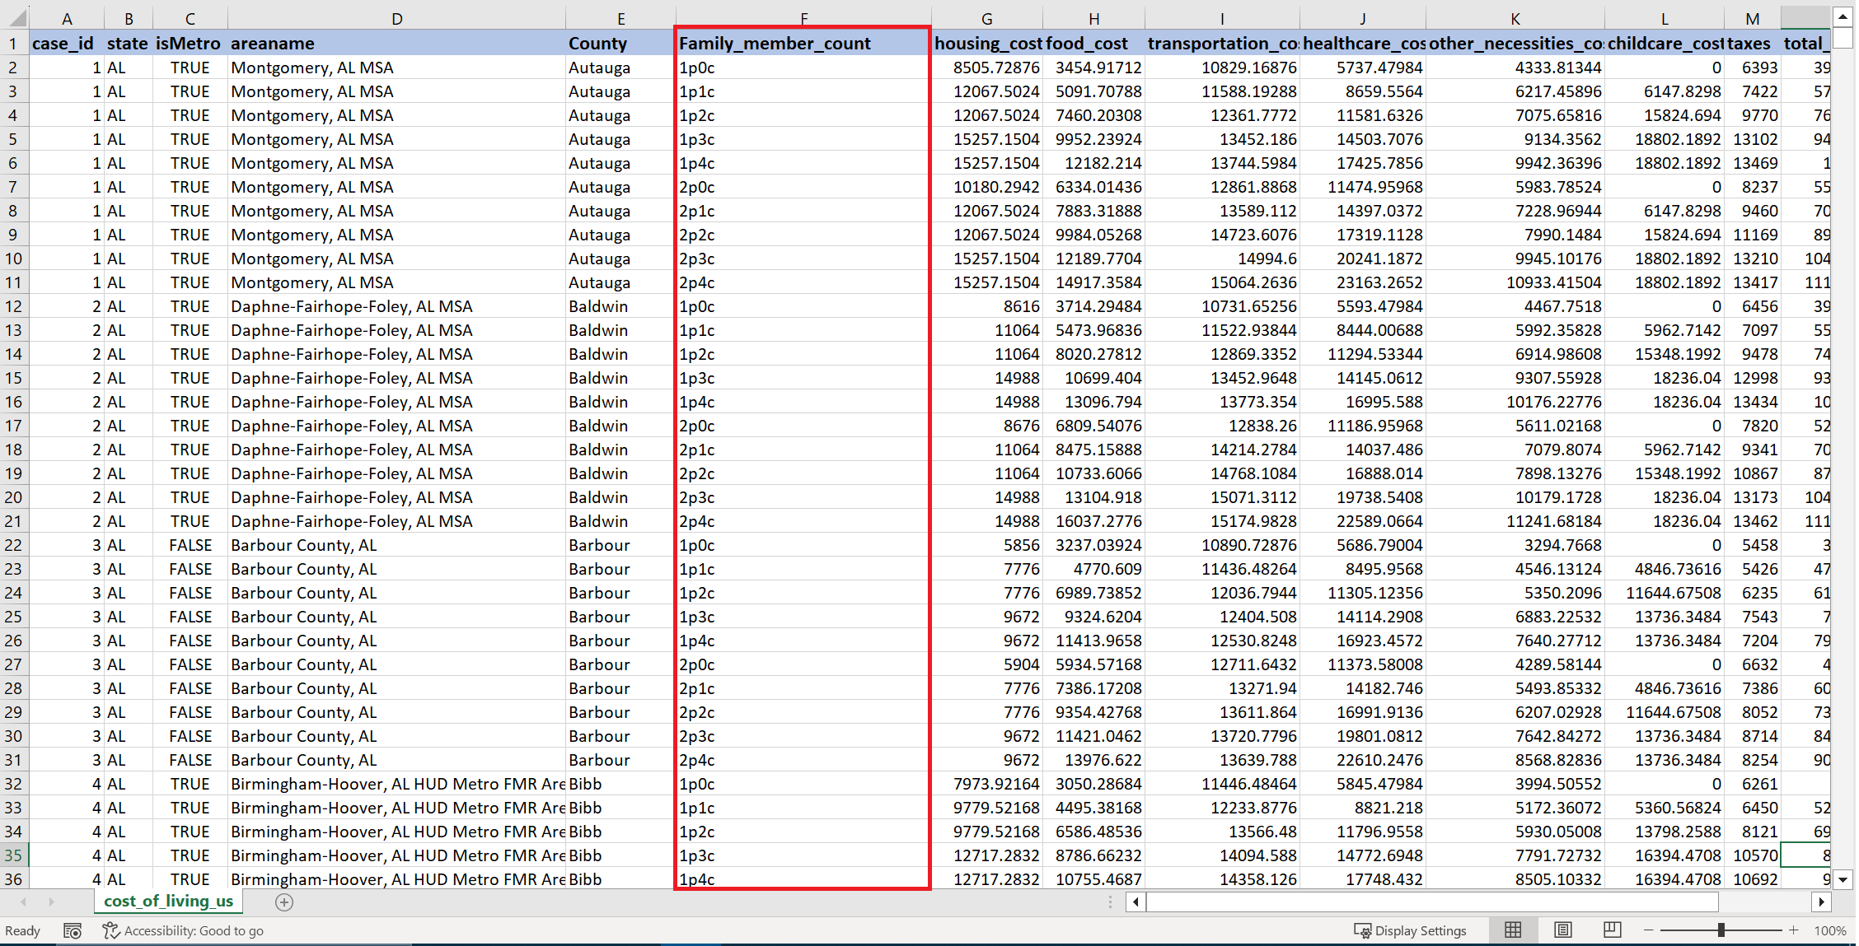
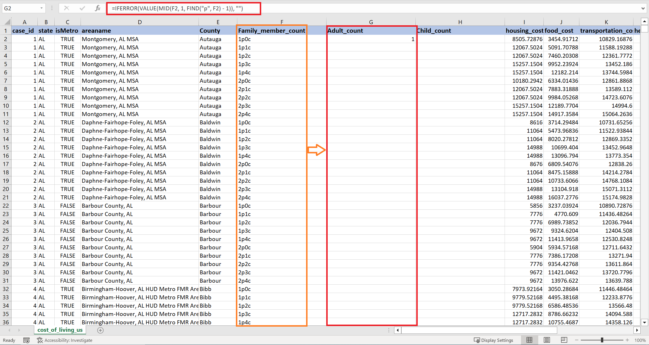
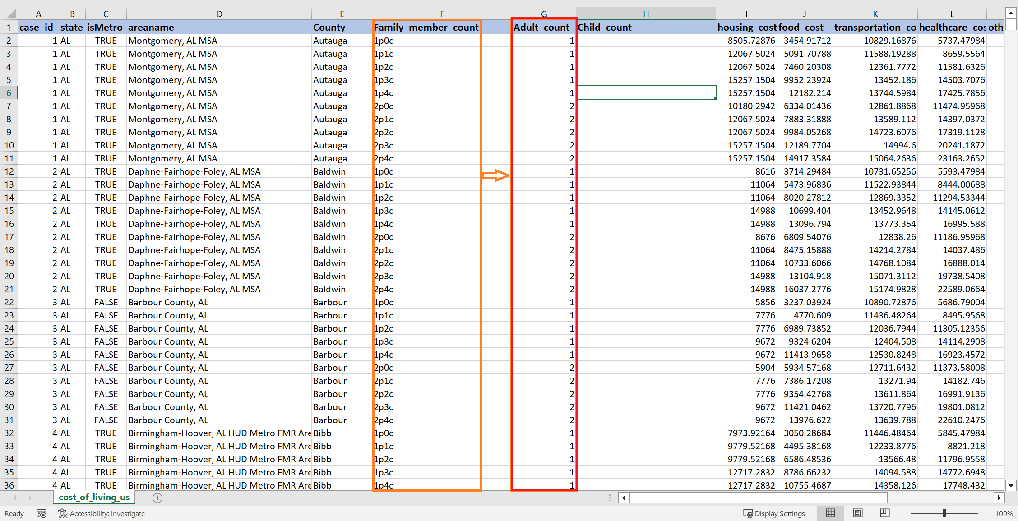
3.Separating Value from one column to two column
Before:
After:

Slide 8
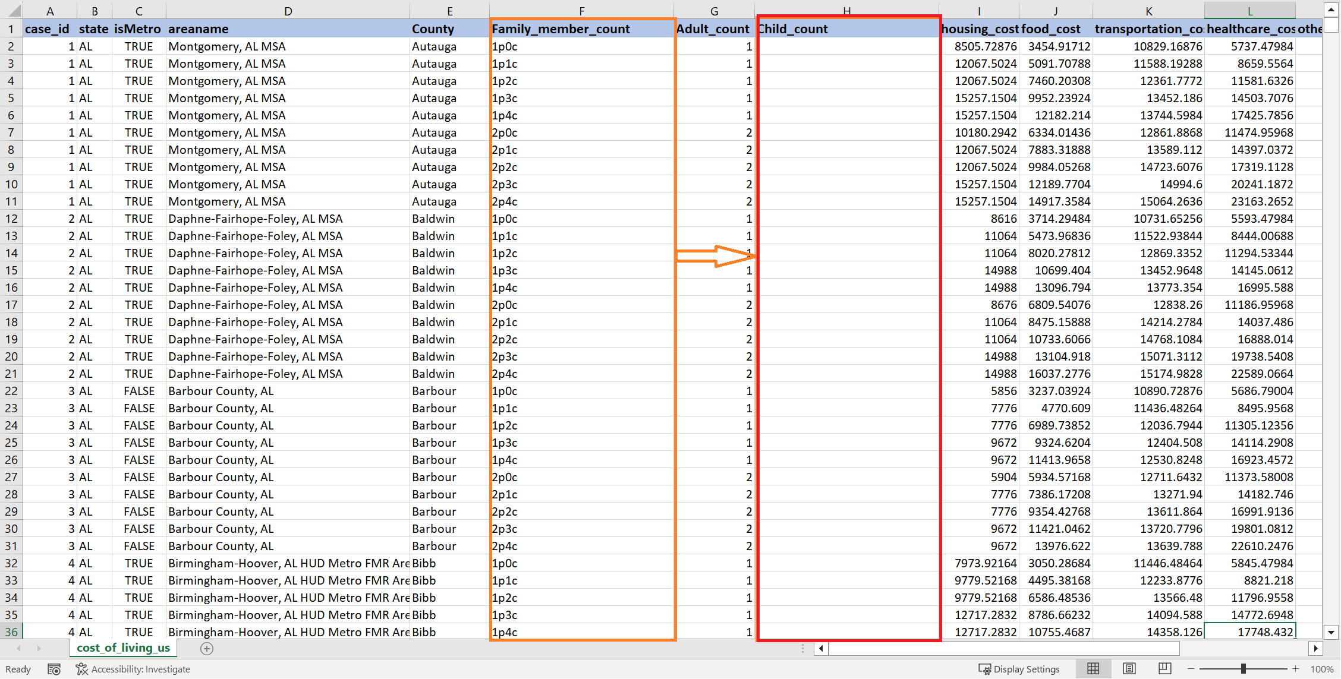
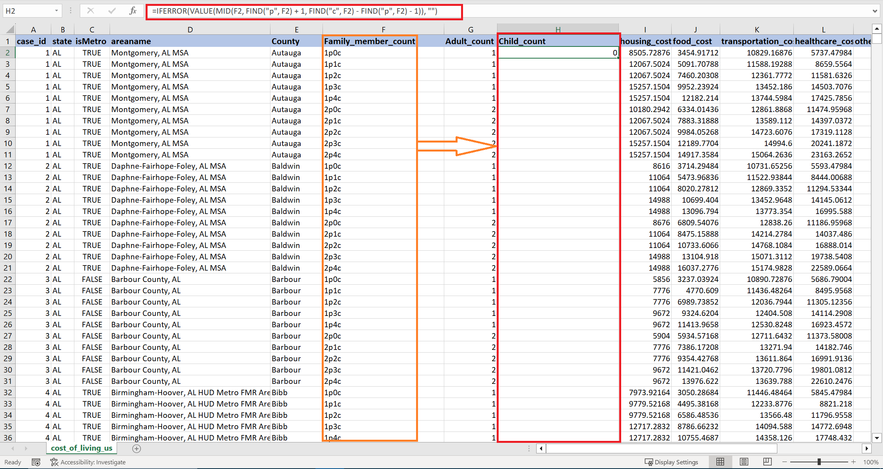
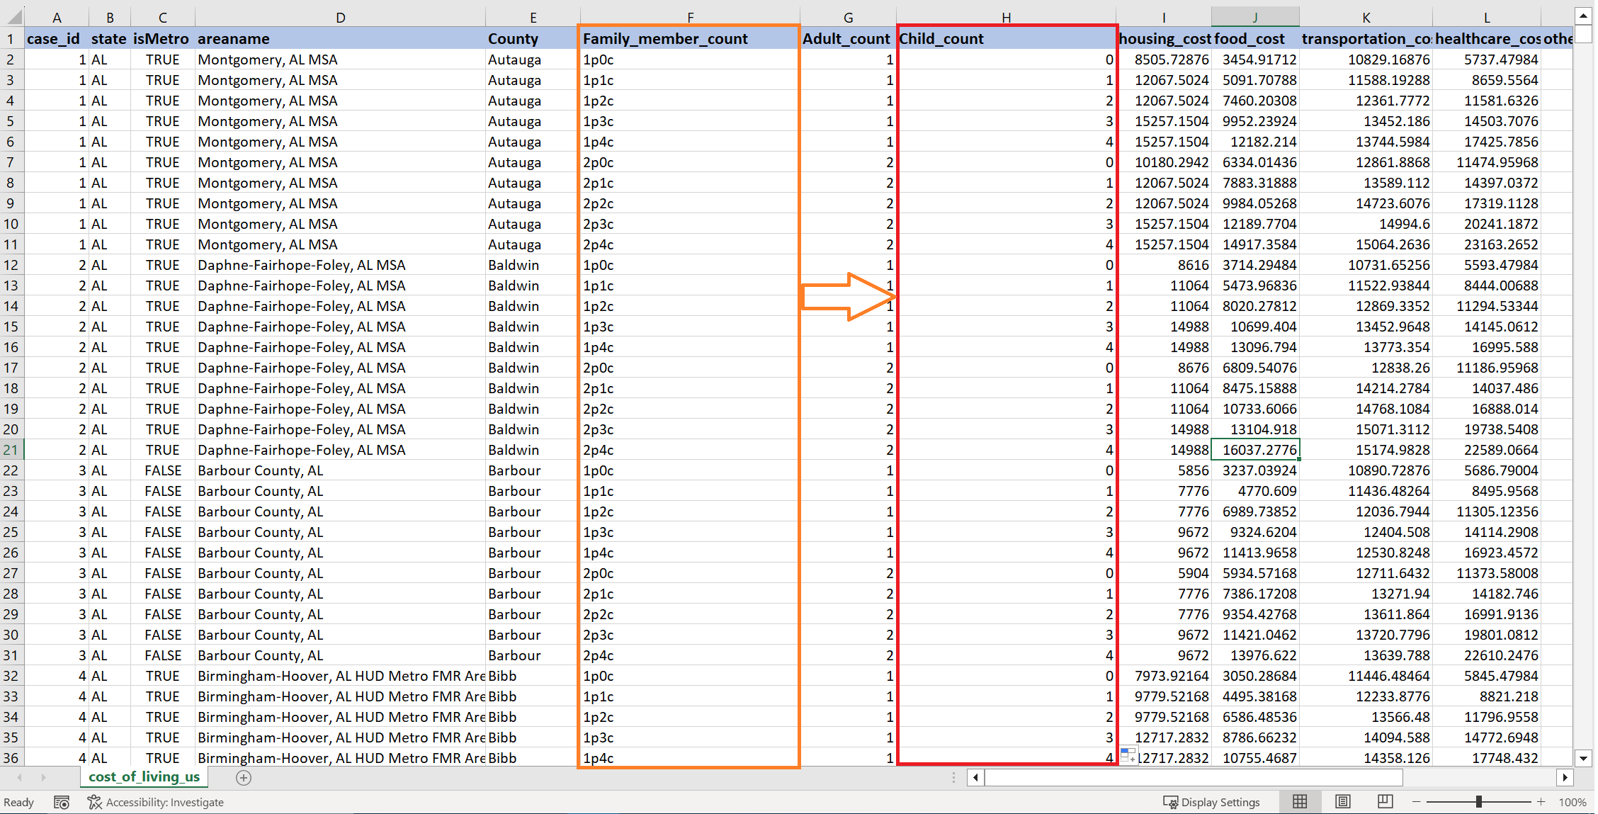
4.Separating Value from one column to two column
Before:
After:

Slide 9
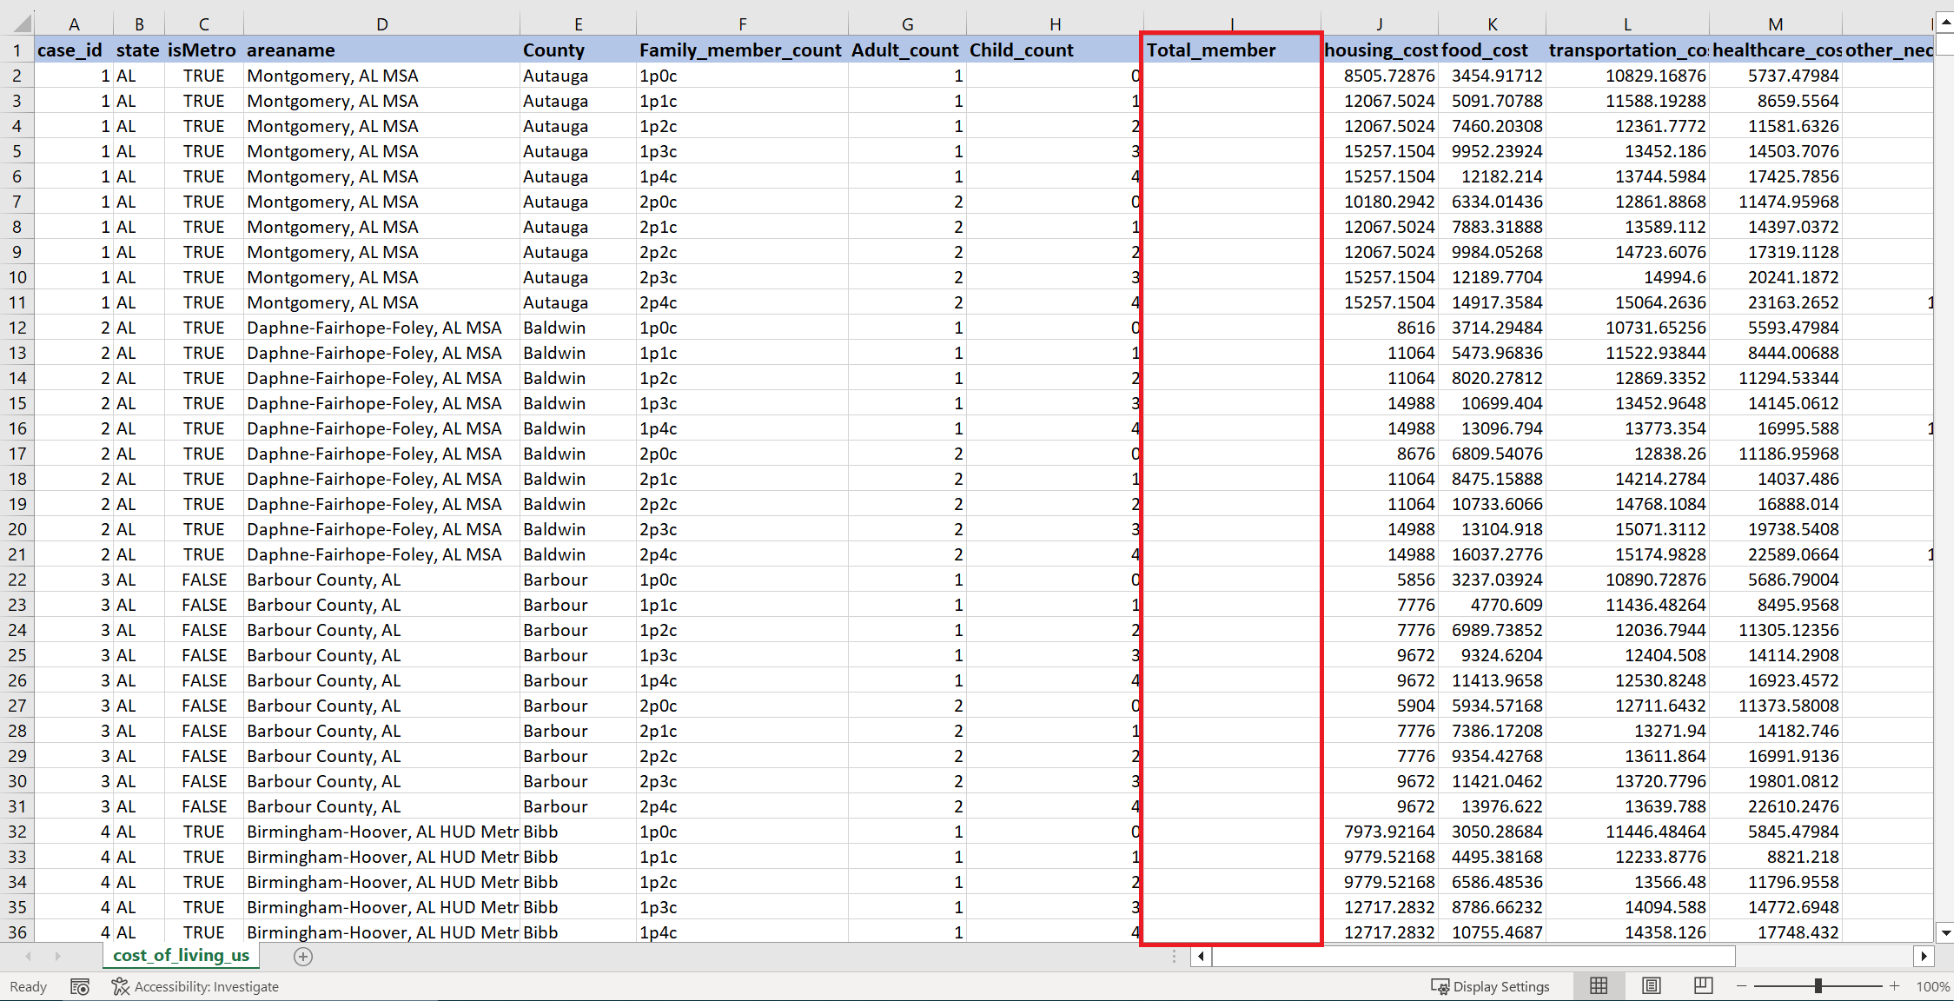
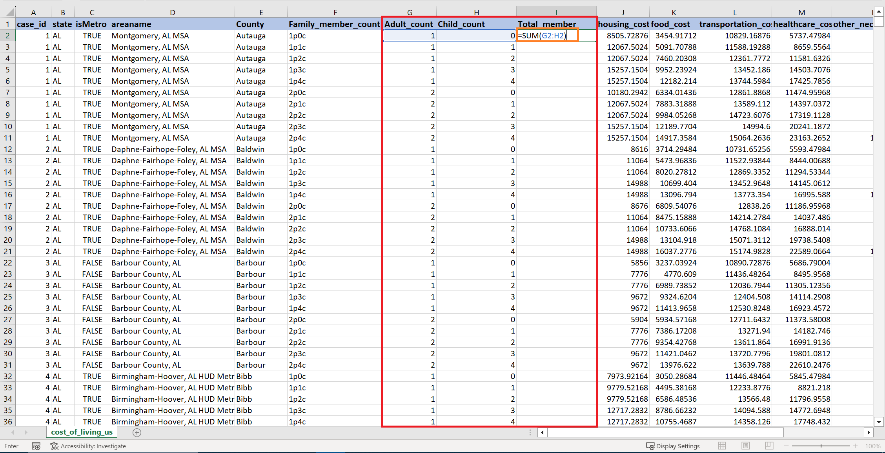
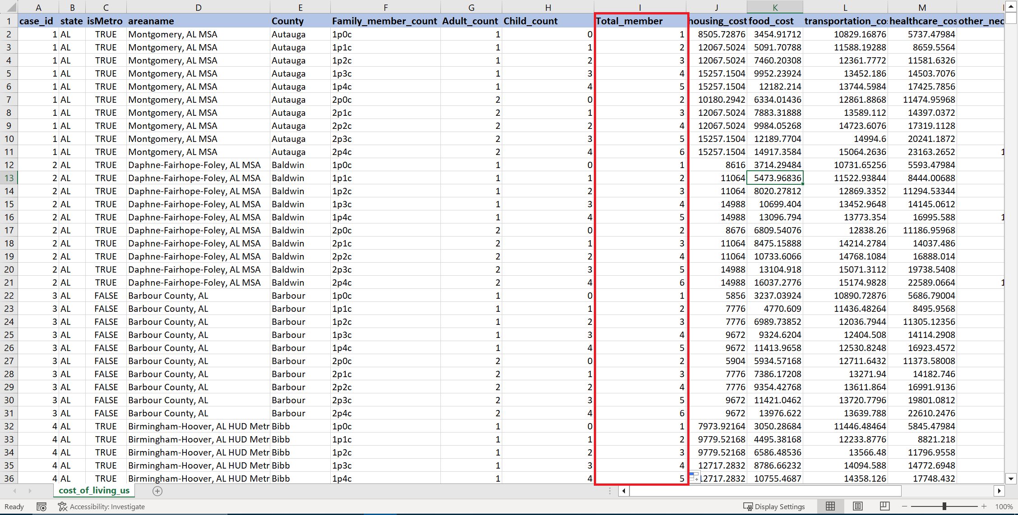
5. Creating Additional Columns Based on Existing Data
Before:
After:

Slide 10
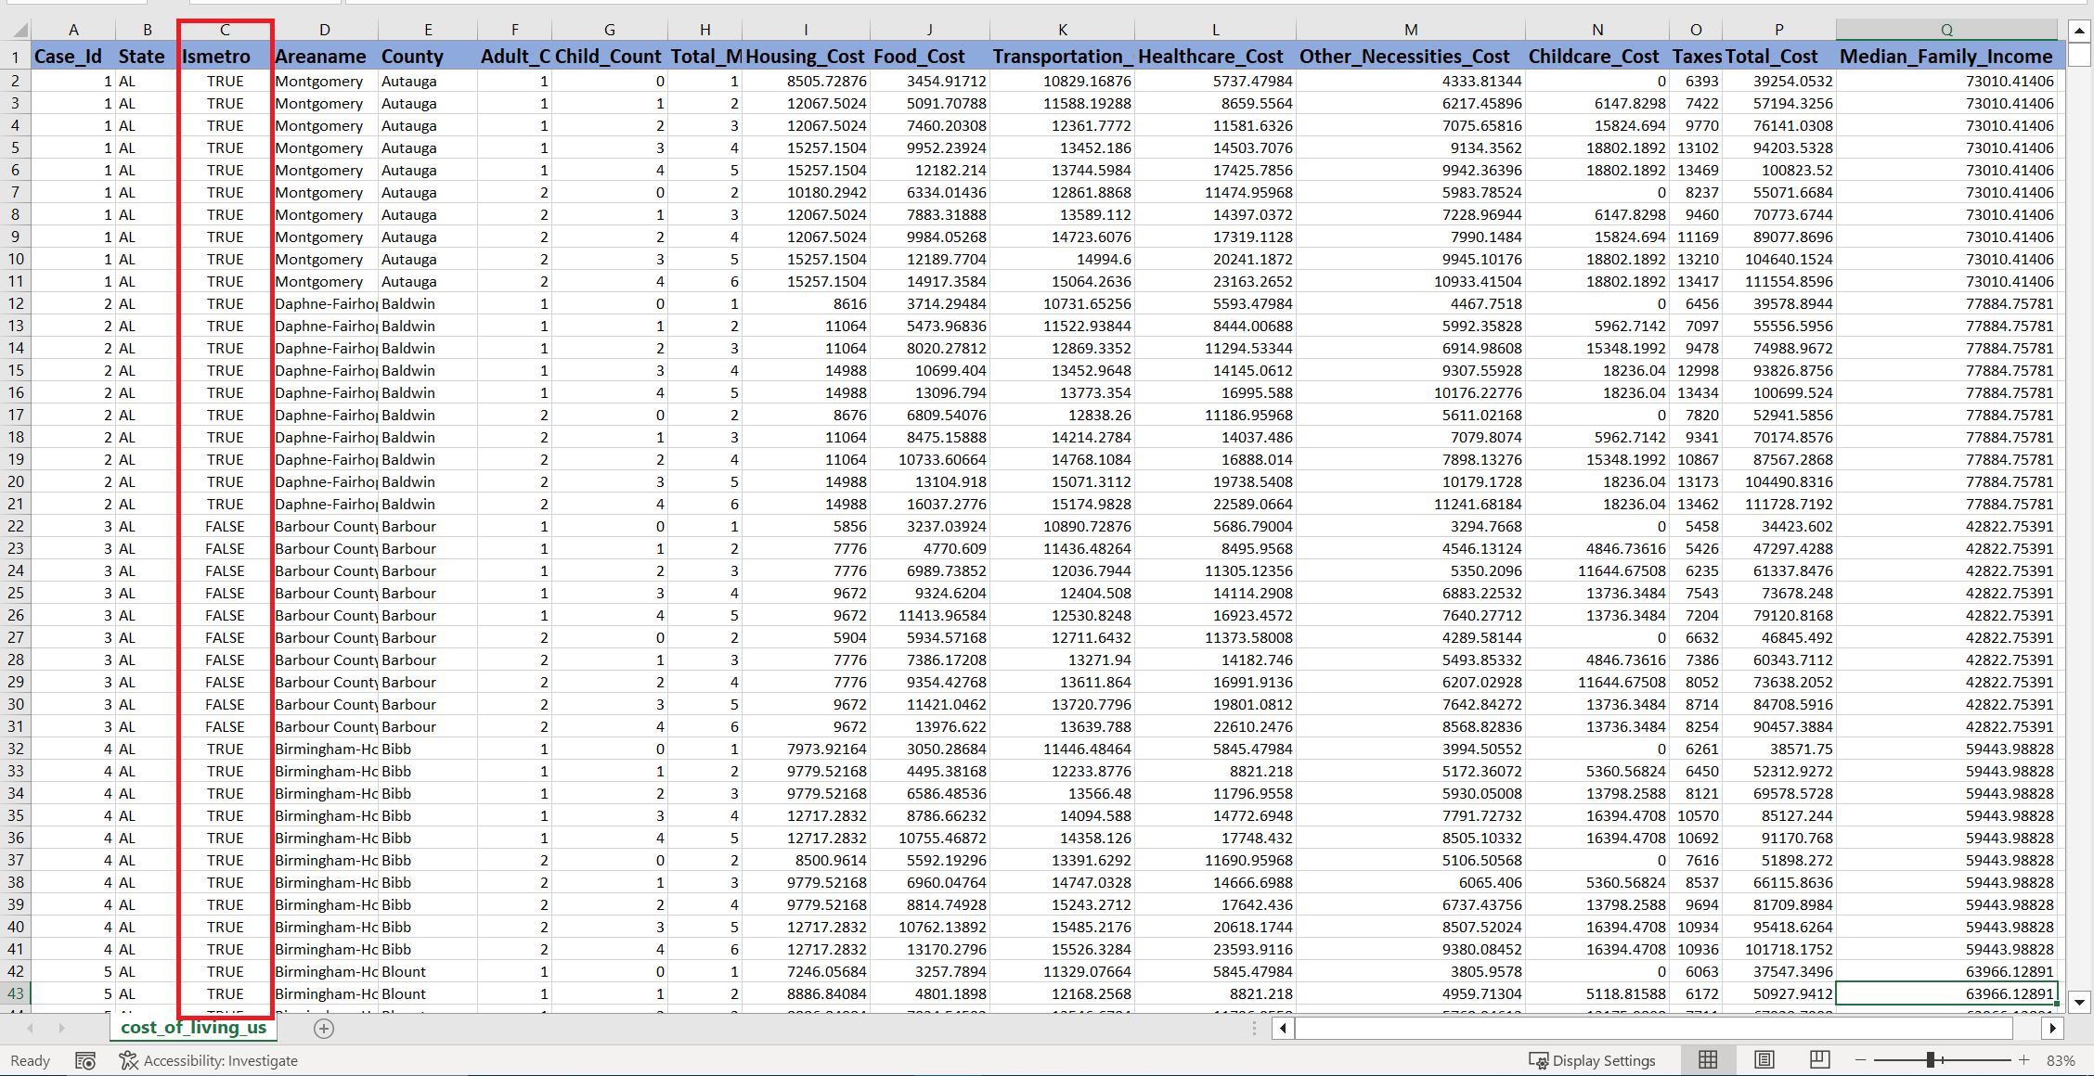
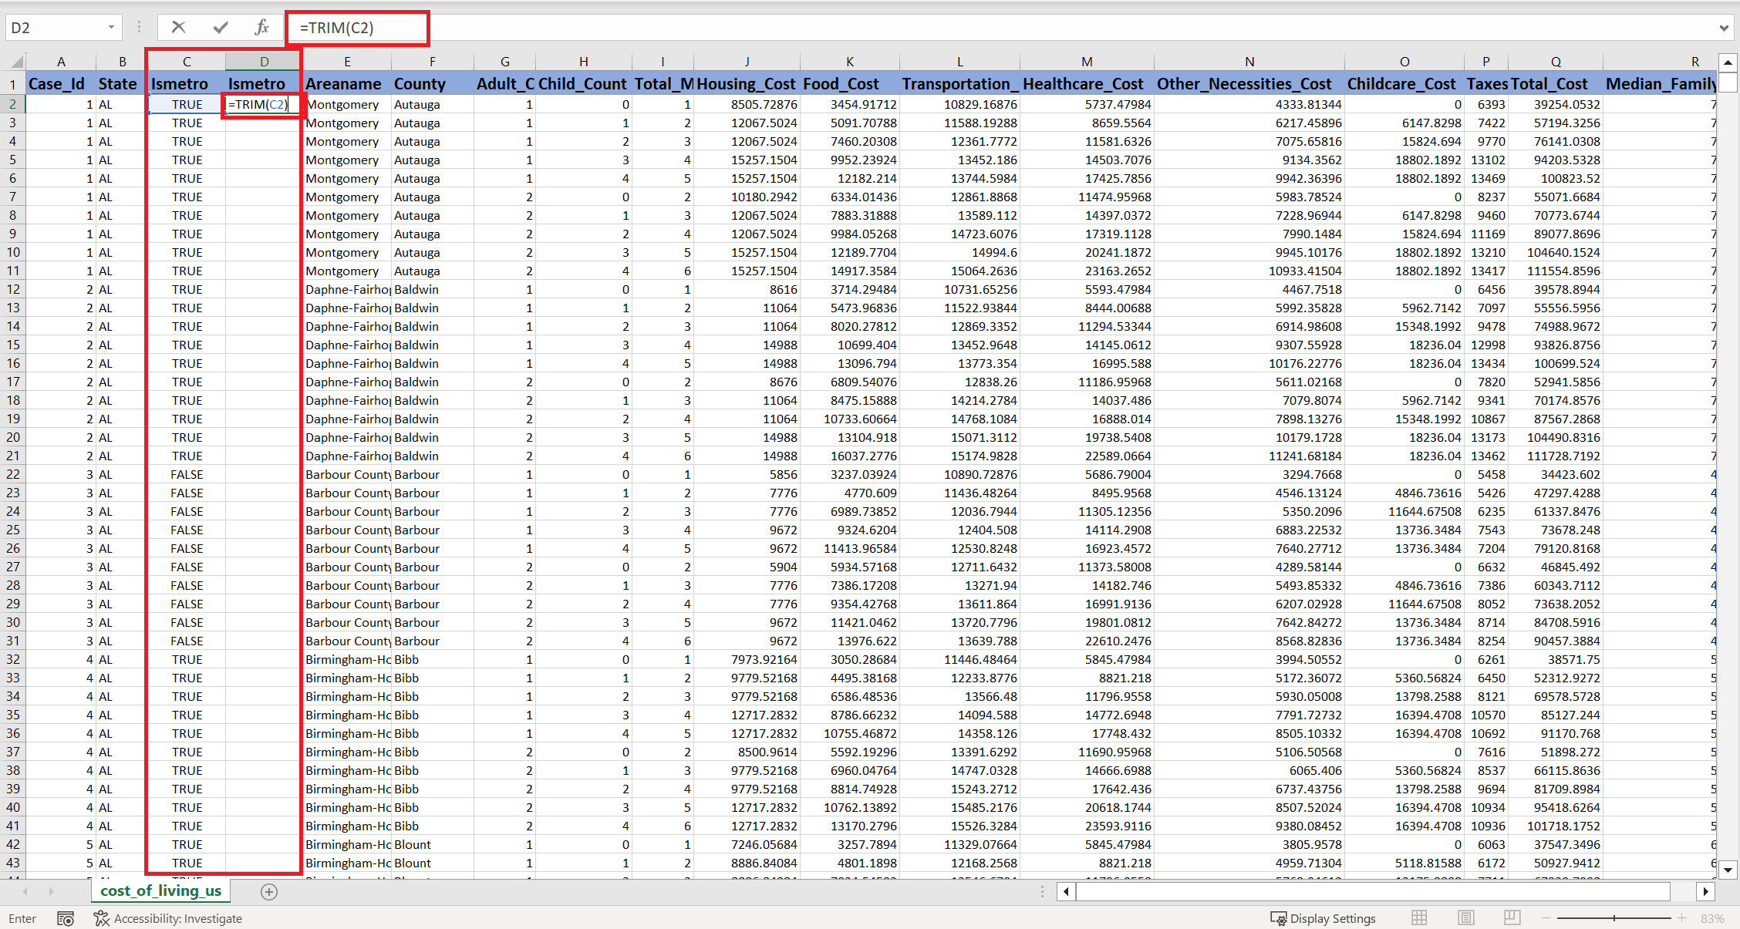
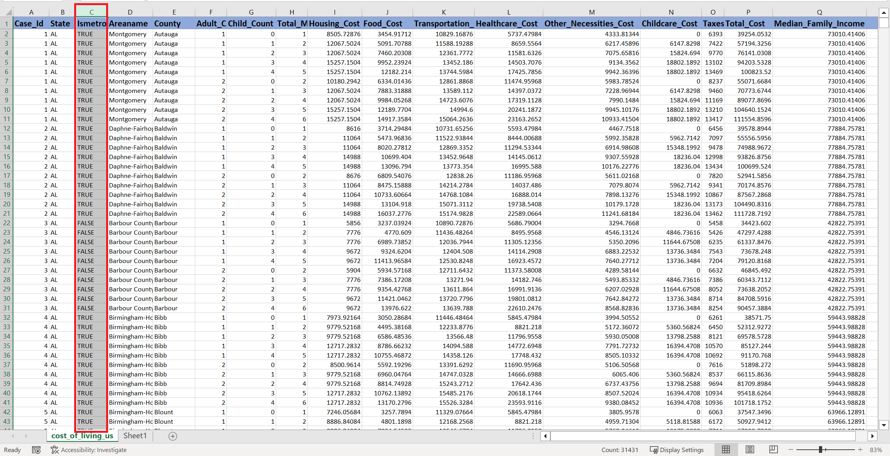
6. Removing Extra Spaces
Before:
After:

Slide 11
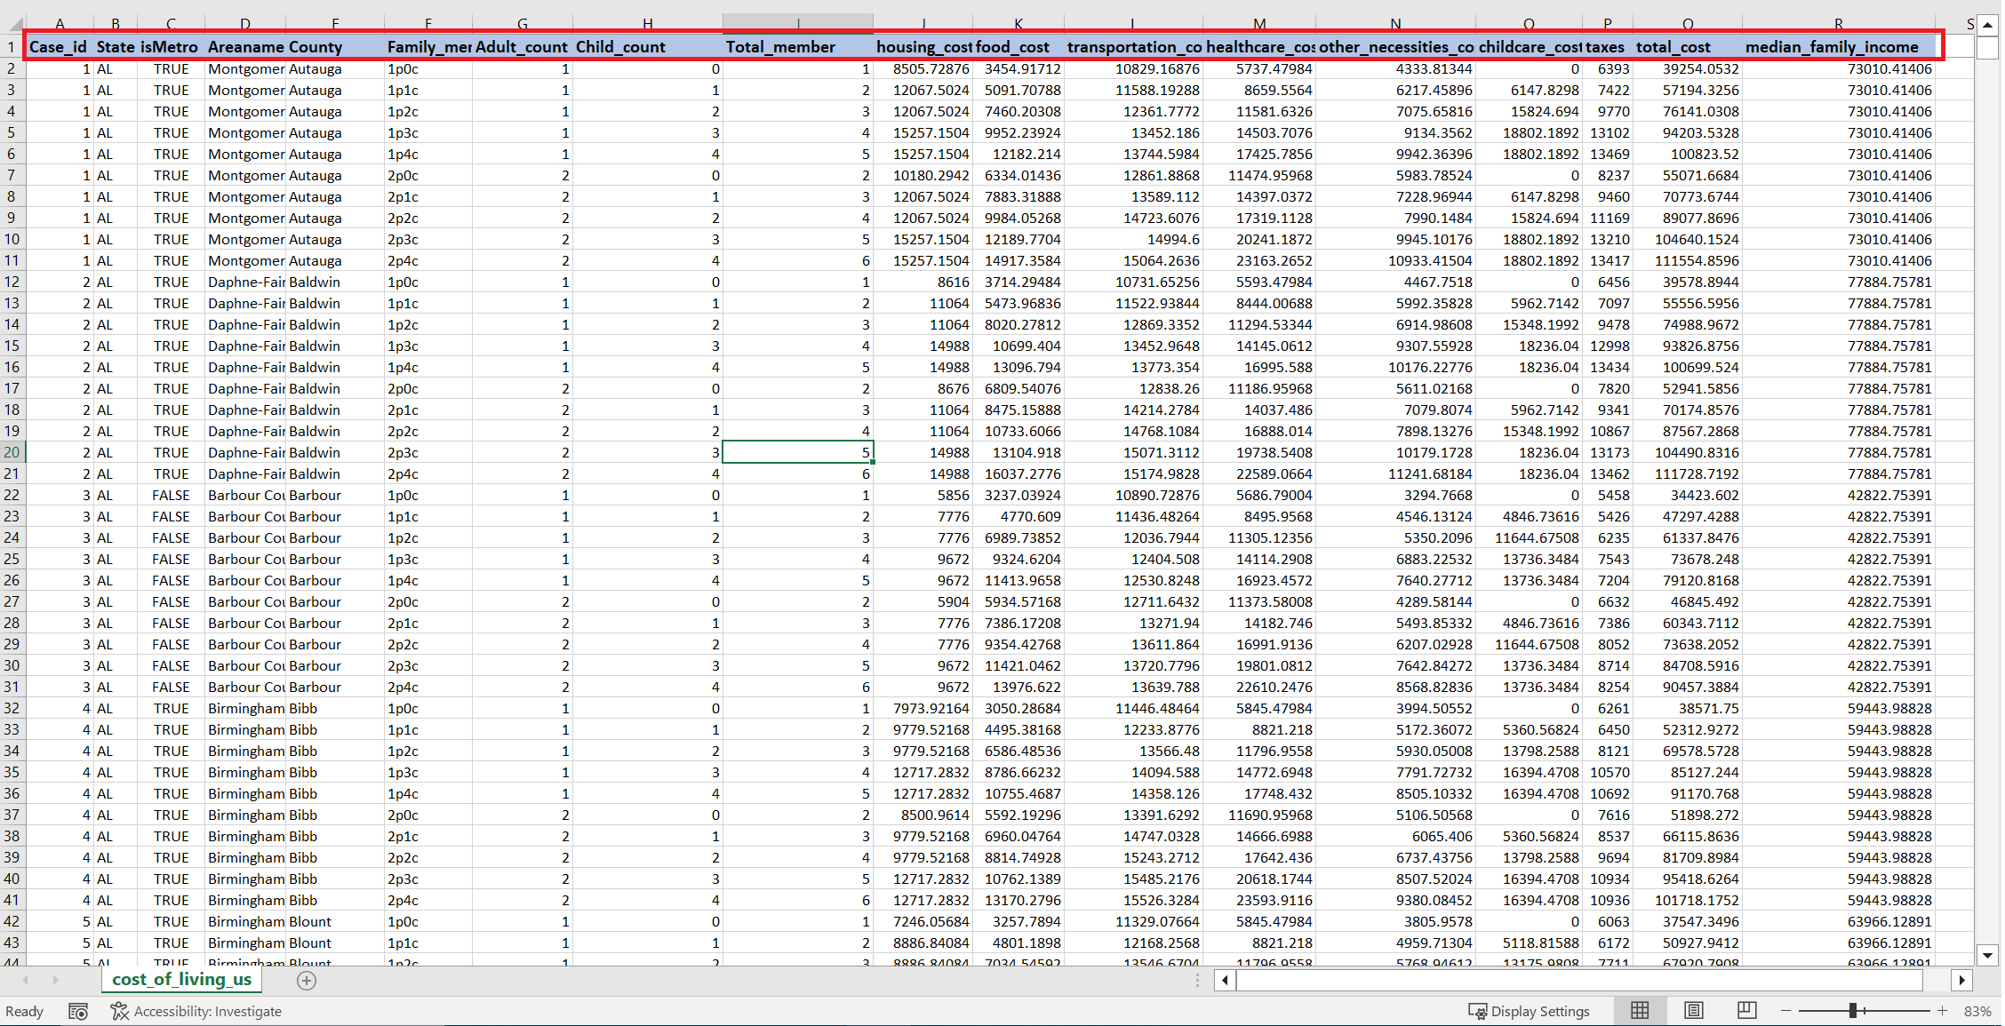
7. Renaming the column header
Before:

Slide 12
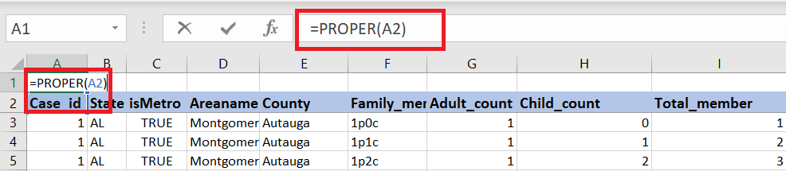
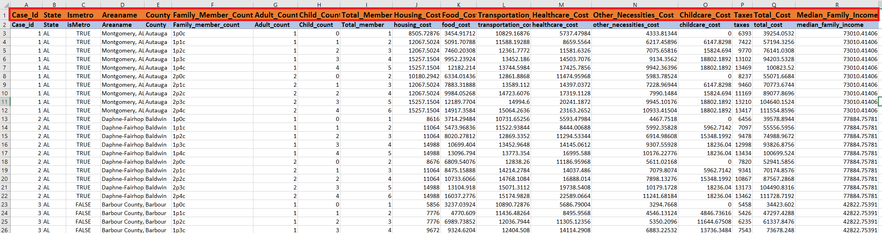
8. Renaming the column header
After:
Performed the same step for rest of the columns

Slide 13
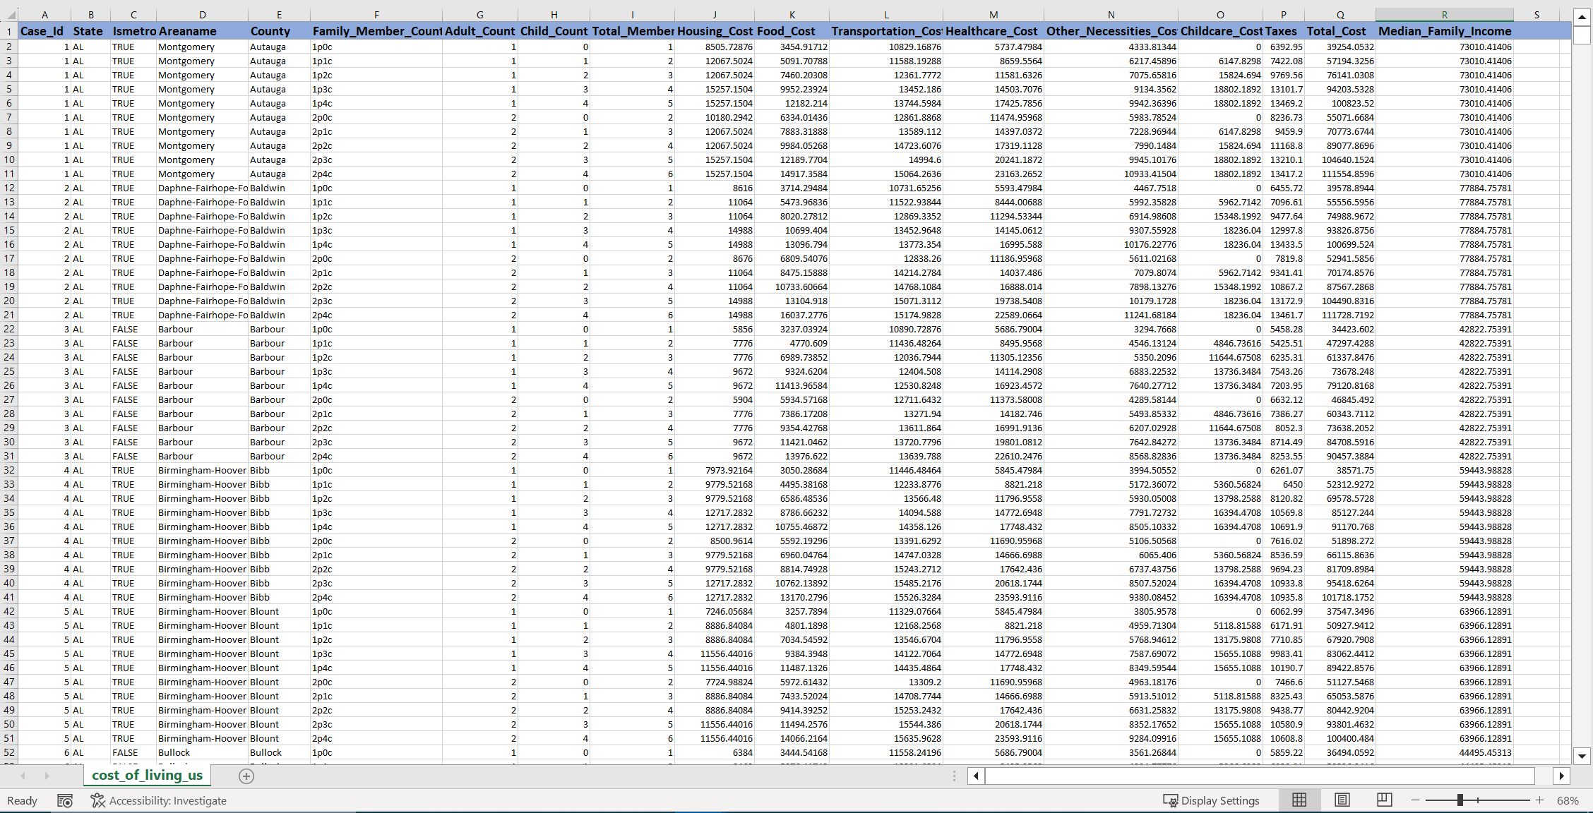
Final Outlook of Dataset

Slide 14
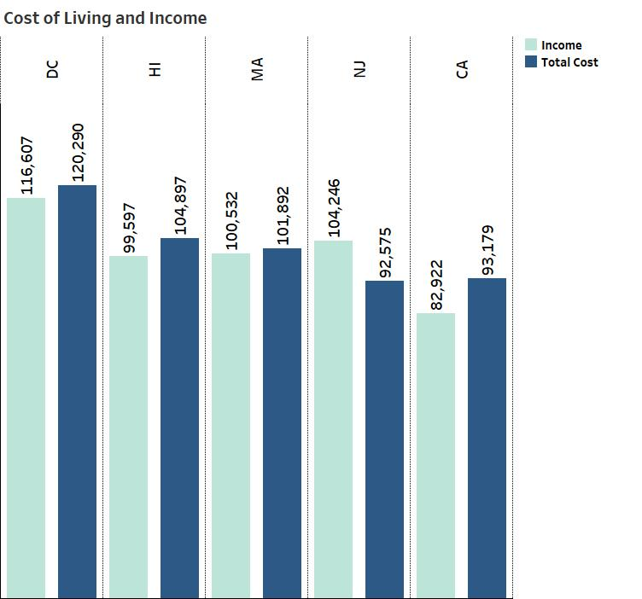
TOP 5 STATES COST OF LIVING & INCOME
Top 5 states that has high cost of living is DC, HI, MA, NJ,CA.
DC is the highest Spending State, and their Family Income is low.
Except New Jersey all other states Family Income is less compared to the Spending.
In California, the income of Family is approx. 10k less than their average spending.

Slide 15
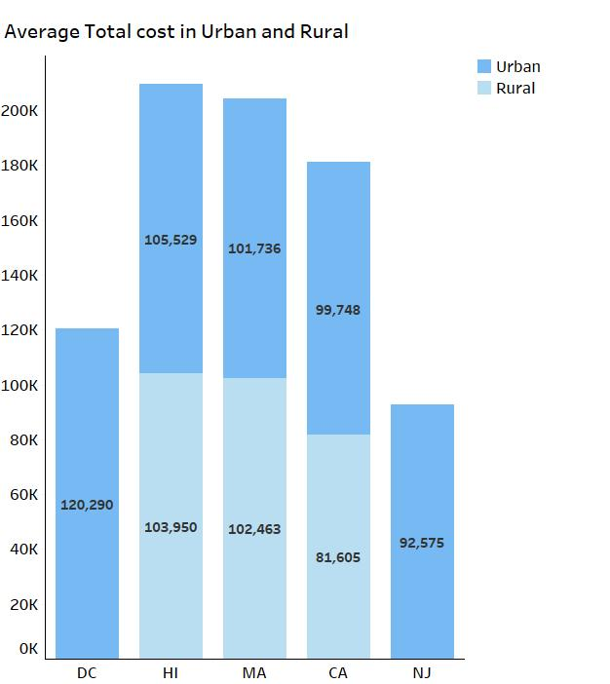
COMPARING THE EXPENSE BETWEEN URBAN AND RURAL
The difference of spending between Urban and rural is 1000 to 2000 dollars.
In Massuchusetts, the rural county family residents spend more than urban county people.
In California, the difference of spending in Urban and rural county is approx. 18k.

Slide 16
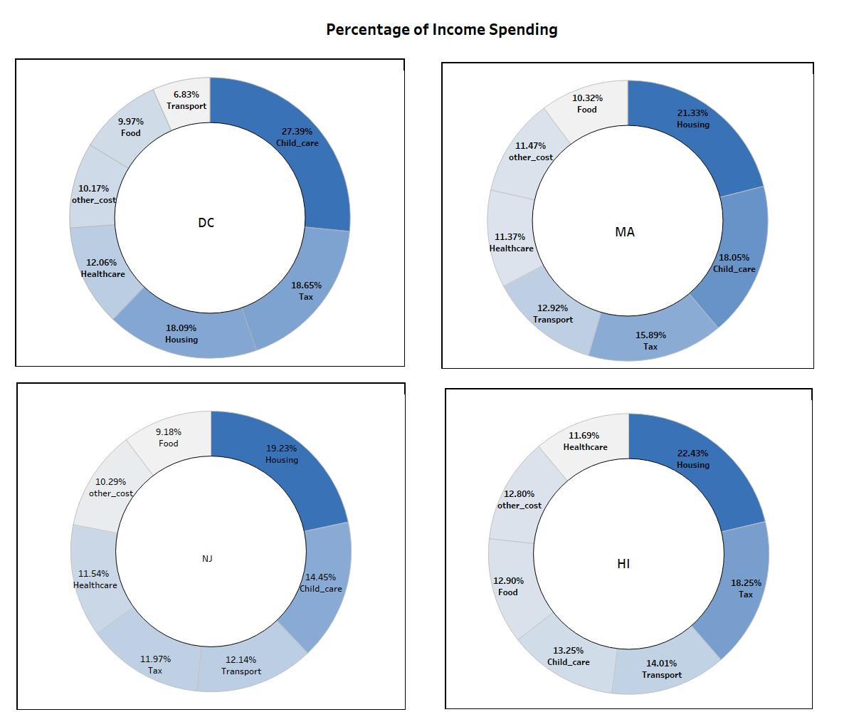
COMPARING THE EXPENSE BETWEEN URBAN AND RURAL
Family spend high on Housing cost.
In DC, the childcare expense is high which is 27.39% compared to Housing which is 18.09% , also the Transpot cost is low compared to other three states.
On average, all State Family spend 10 to 12 % of their Income in Food and Transport.

Slide 17
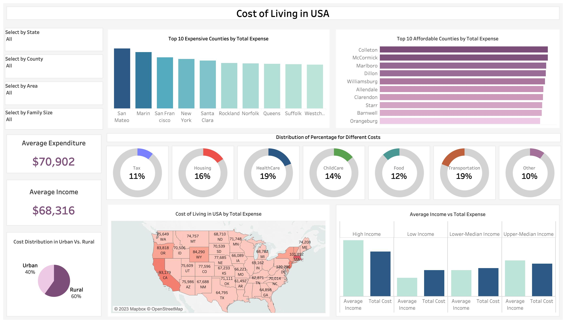
Interactive Dashboard

Slide 18
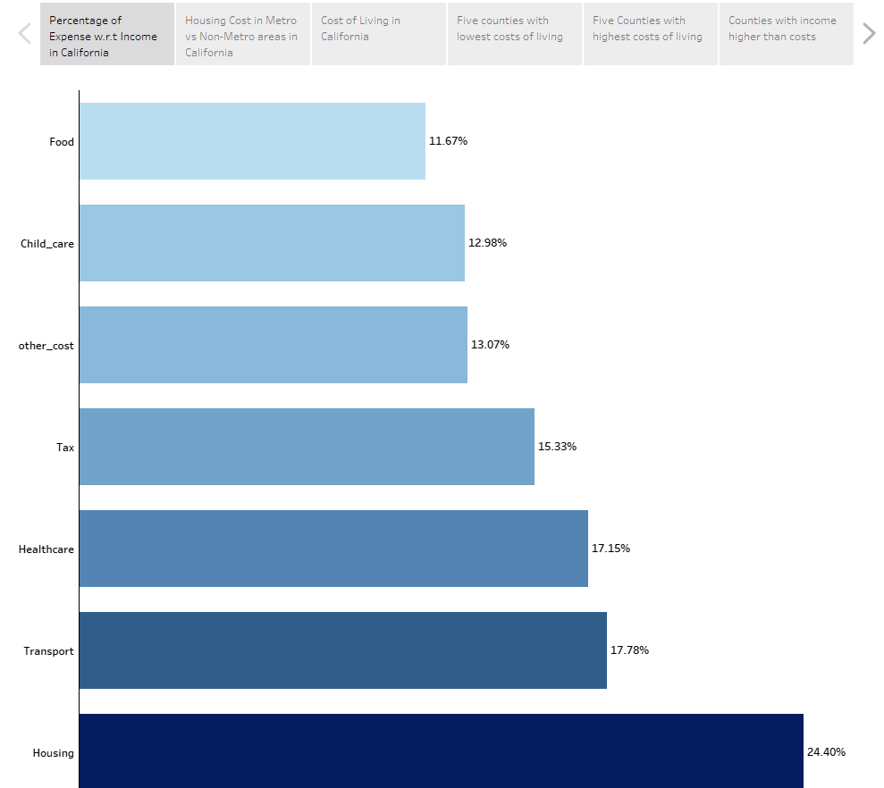
Story
Financial allocations of Californians, showcasing the distribution of their income across various essential categories.
Cumulative total: 112.38%!

Slide 19
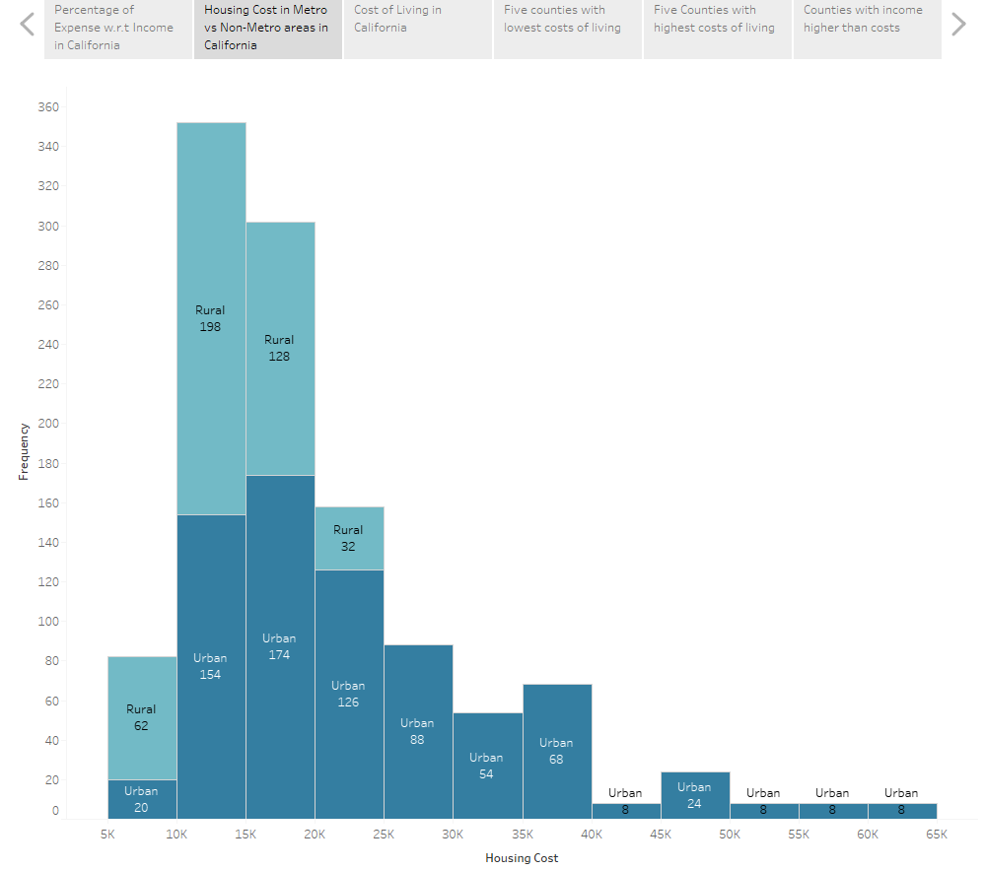
Story
Housing cost stands out as the most significant cost-of-living component.
This histogram shows the frequency of different housing cost ranges between urban and rural areas.

Slide 20
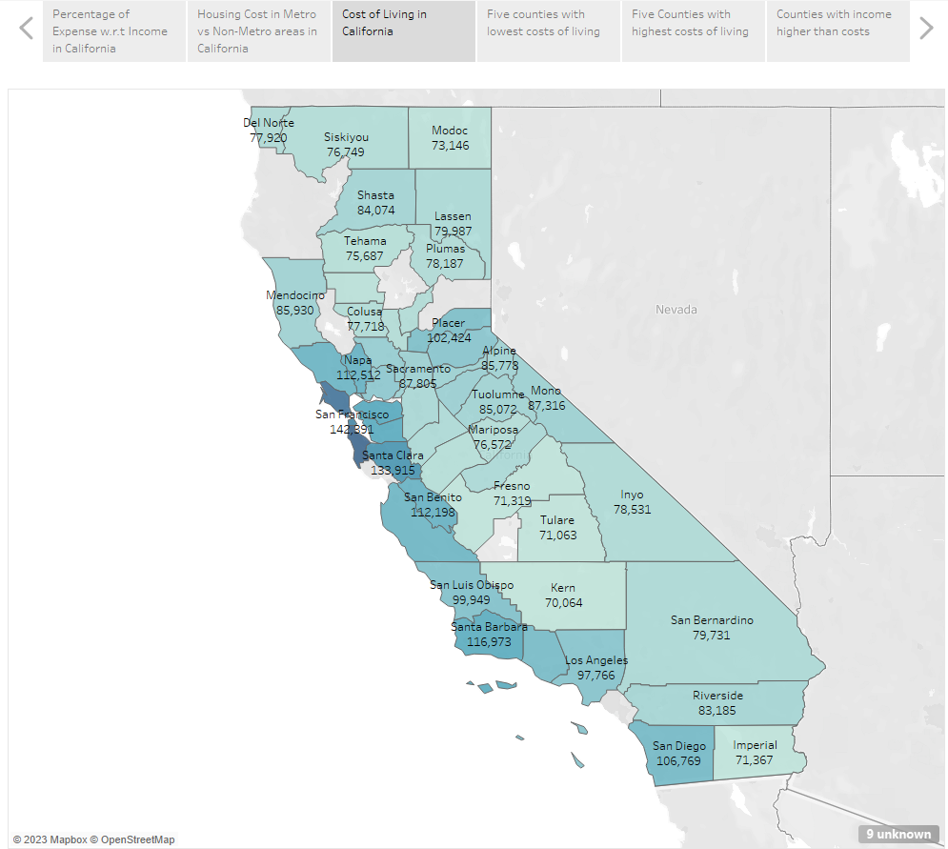
Story
This map shows the cost of living across various counties in California.
Bottom 5 counties: Tulare ($71,063), Kern ($70,064), Fresno ($71,319), Imperial ($71,367), and Modoc ($73,146).
Top 5 counties: San Mateo ($167,022), Marin ($157,044), San Francisco ($142,391), Santa Cruz ($137,830), and Santa Clara ($133,915).
The income gaps between the top five and the bottom five counties are about $43,000 to $103,000.

Slide 21
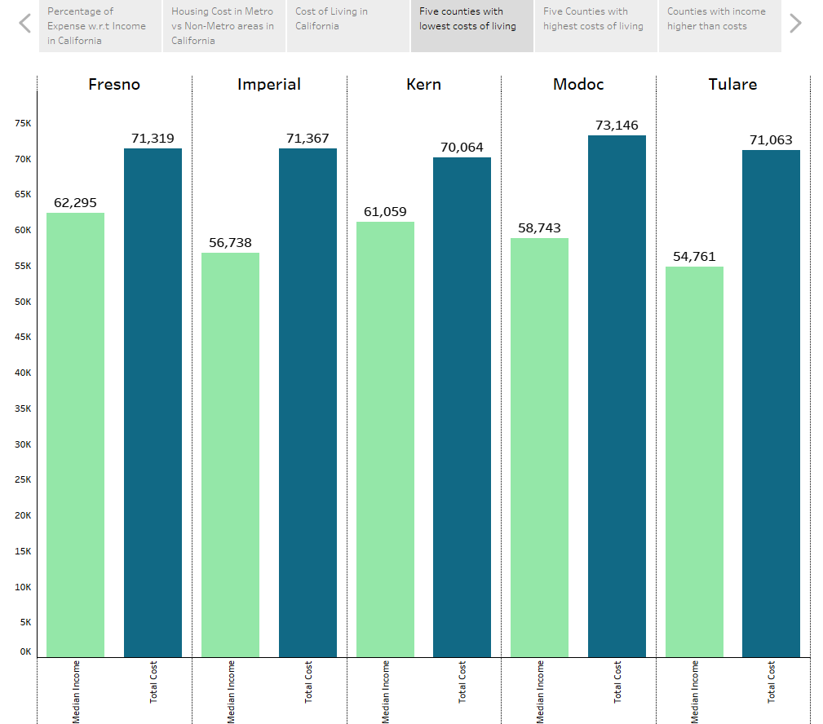
Story
Having the lowest costs of living does not equate to affordability.
Total costs are higher than median incomes in the bottom 5 counties.
The gap is between $9,000 and $17,000.

Slide 22
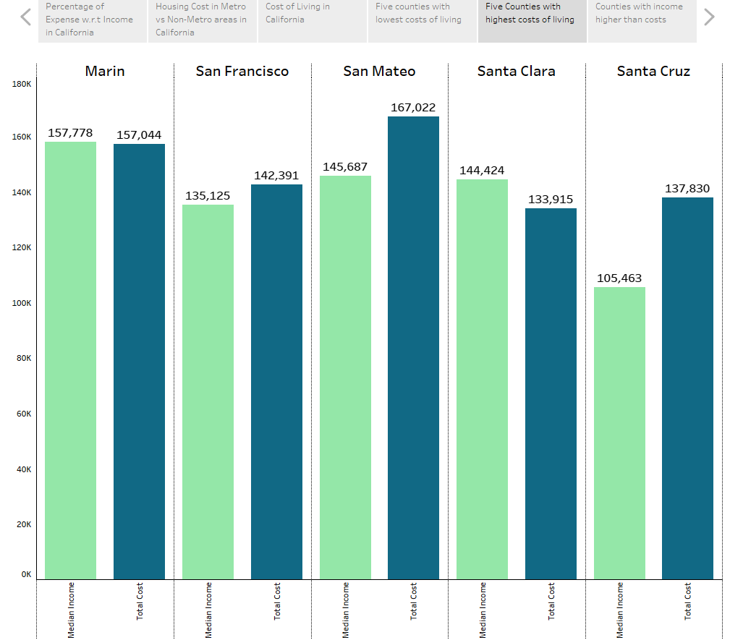
Story
Total costs are higher than median incomes in San Francisco, San Mateo, and Santa Cruz.
Residents of Marin county and Santa Clara earn slightly more than what they spend. However, the margin is relatively narrow, with only less than $1,000 in Marin, and $11,000 in Santa Clara.

Slide 23
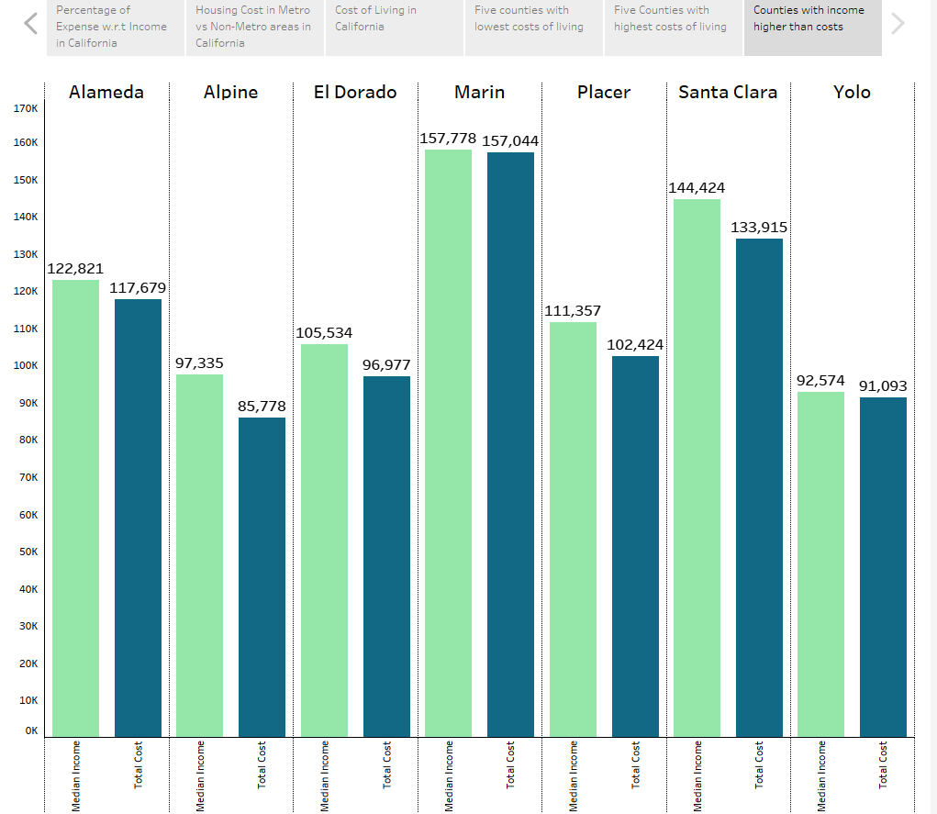
Story
For those seeking a comfortable and economically sustainable living experience in the Golden State, these counties present promising options.

Slide 24

Limitations and Future Works
LIMITATIONS
The absence of date-specific data
Restricted coverage to a limited number of counties
FUTURE WORKS
Integration of API
Implementation of debt reduction strategies

Slide 25
Conclusion
Hawaii is considered the most expensive place to live for individuals or couples.
While for family sizes such as one parent with one child (1p1c), one parent with two children, one parent with three children, one parent with four children, two parents with one child, two parents with two children, two parents with three children, and two parents with four children, Washington, D.C. is the most expensive.
On the other hand, living in Ohio is affordable, especially for a single person. And for bigger families, like two adults with four children (2p4c), Mississippi is the most affordable place.
Los Alamos is a great place where people spend only half of what they earn. On the other hand, in Bronx County, people spend more money than they make.

Slide 26

Thank you!
Any Questions?

